Slide 1



Sales Analysis Report
View in Power BI
Last data refresh:
29/04/2024 18:04:52 UTC
Downloaded at:
10/07/2024 00:10:57 UTC

Slide 2
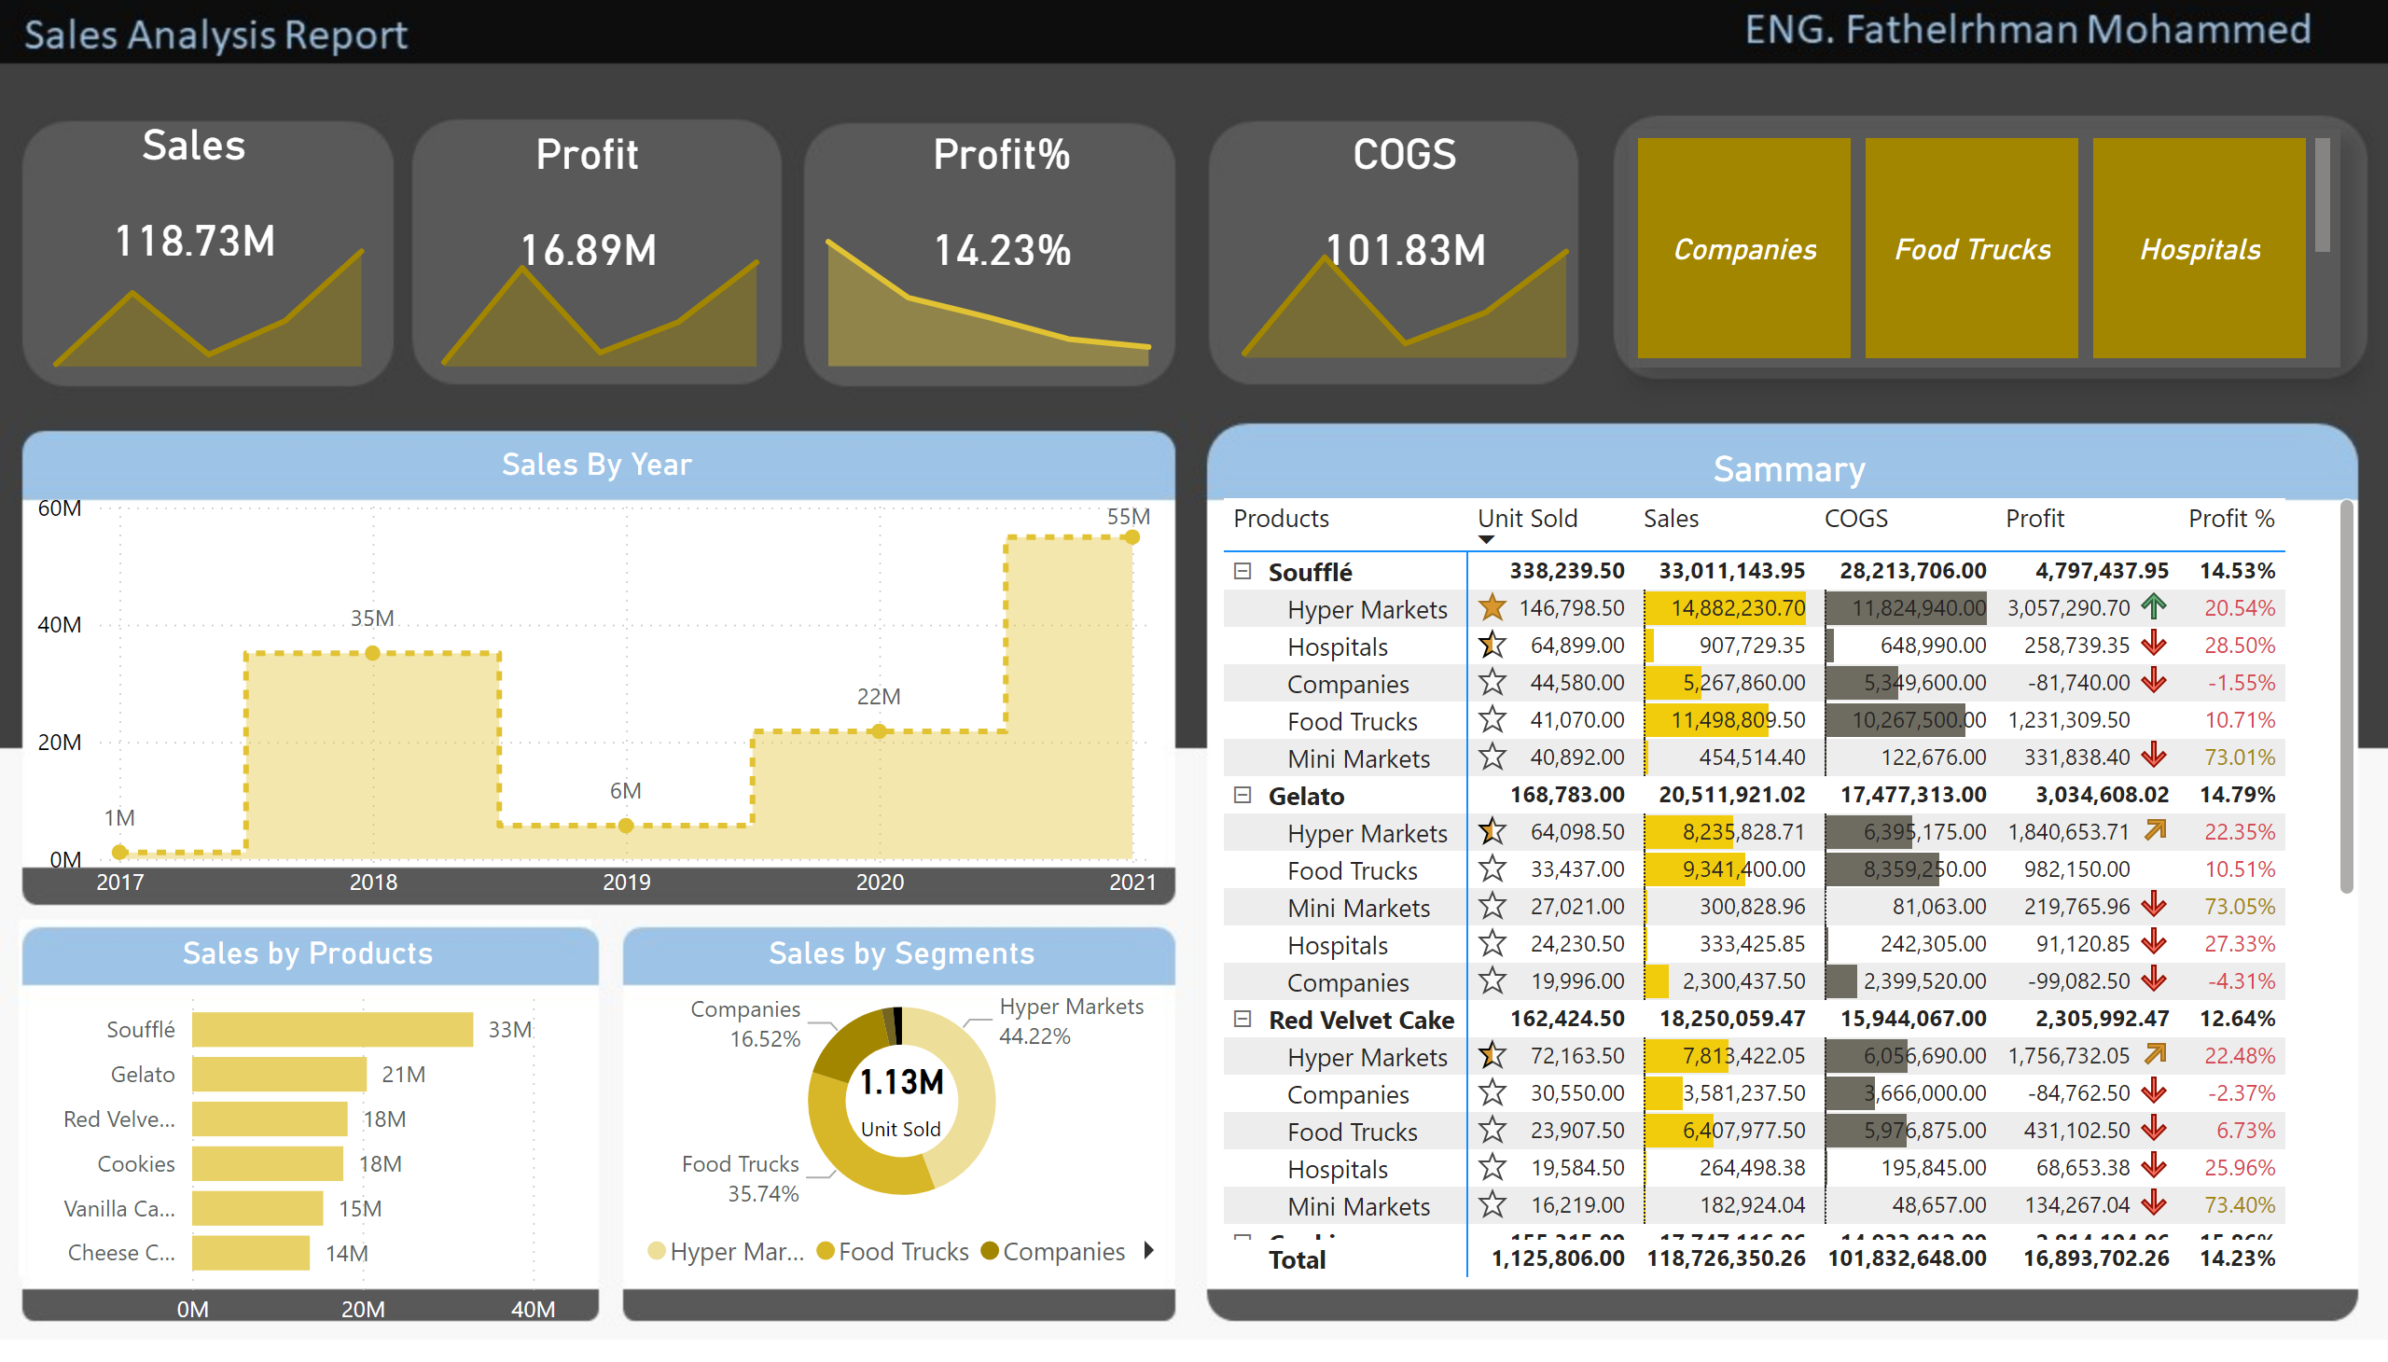
Page 1
Notes:
advancedSlicerVisual
No alt text provided
Sammary
No alt text provided
COGS
No alt text provided
Sales by Segments
No alt text provided
Sales by Products
No alt text provided
Sales By Year
No alt text provided
areaChart
No alt text provided
Profit%
No alt text provided
COGS
No alt text provided
areaChart
No alt text provided
areaChart
No alt text provided
Profit
No alt text provided
areaChart
No alt text provided
Sales
No alt text provided

Slide 3
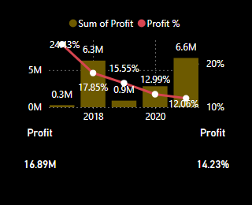
tooltips
Notes:
lineStackedColumnComboChart
No alt text provided
Profit
No alt text provided
Profit
No alt text provided

